Slide 1

PROGRAMMING IN C

Slide 2
Pointers and dynamic memory allocation and C pre-processor
5.1 Introduction to pointers: Pointer declaration and initialization, Pointer addition and subtraction, Evaluating pointer expressions Pointers and Functions: Pass by Reference, Returning pointers from functions, File Handling
5.2 Dynamic Memory Allocation using Pointers: Dynamic memory allocation using malloc(), calloc() and realloc() and deallocation of memory using free()
5.3 C Pre-processor, Directives, Macros

Slide 3
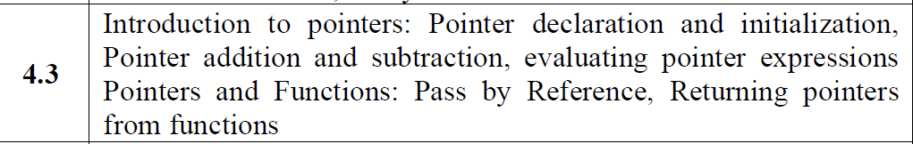

Slide 4
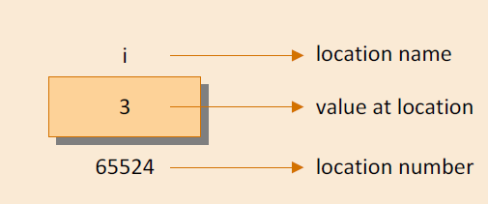
Introduction
Consider the declaration,
int i = 3 ;
This declaration tells the C compiler to:
(a) Reserve space in memory to hold the integer value.
(b) Associate the name i with this memory location.
(c) Store the value 3 at this location.

Slide 5
What is pointer?
Pointers are nothing but memory address
Pointer is a variable that represents the location of data item
Pointers can be used for variety of applications such as to create complex data structures, trees , linked lists, linked stacks, linked queues, and graphs
For dynamic allocation of memory

Slide 6
How to use pointers?
Pointer declaration
Pointer initialization
Pointer Dereferencing

Slide 7
Pointer Declaration & initialization
Pointer initialization is the process where we assign some initial value to the pointer variable.
We generally use the ( & ) address of operator to get the memory address of a variable and then store it in the pointer variable.
int x = 100;
int * ptr;
ptr = &x;
In pointer declaration, we only declare the pointer but do not initialize it.
To declare a pointer, we use the ( * ) dereference operator before its name.
int *ptr;

Slide 8
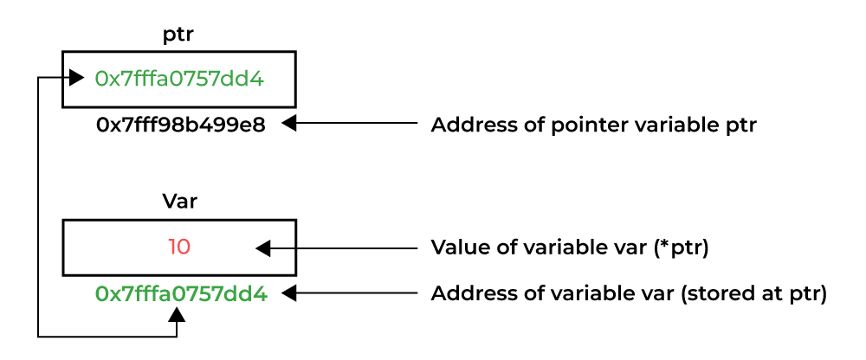
Pointer Dereferencing
Dereferencing a pointer is the process of accessing the value stored in the memory address specified in the pointer. We use the same ( * ) dereferencing operator that we used in the pointer declaration.

Slide 9
Recap of Pointer Terms
Term | Meaning
ptr | pointer (holds address)
&num | address of num
*ptr | Value at that address

Slide 10
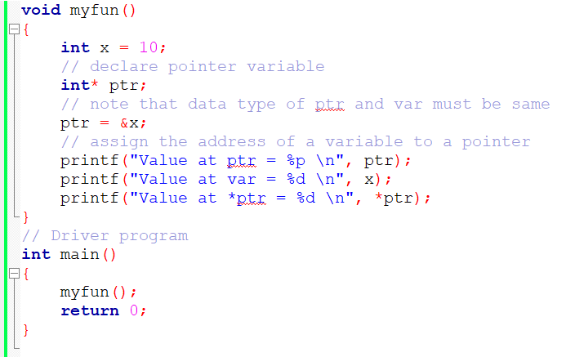

Example:1

Slide 11
Pointer arithmetic
increment/Decrement of a Pointer
Addition of integer to a pointer
Subtraction of integer to a pointer
Subtracting two pointers of the same type
Comparison of pointers

Slide 12
Addition of Integer to Pointer
When a pointer is added with an integer value, the value is first multiplied by the size of the data type and then added to the pointer.
Example:
Consider the same example as above where the ptr is an integer pointer that stores 1000 as an address. If we add integer 5 to it using the expression, ptr = ptr + 5, then, the final address stored in the ptr will be ptr = 1000 + sizeof(int) * 5 = 1020.

Slide 13
Subtraction of Integer to Pointer
When a pointer is subtracted with an integer value, the value is first multiplied by the size of the data type and then subtracted from the pointer similar to addition.

Slide 14
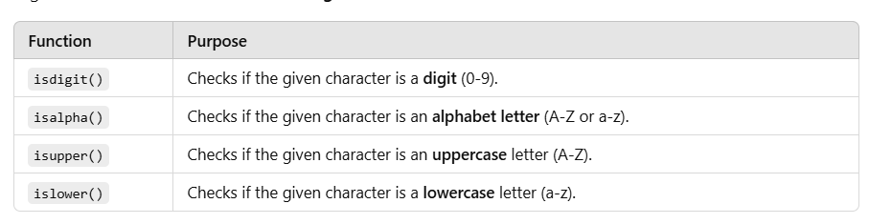
Example
Write a program in C using pointer which takes an input from the user and then checks whether it is a number or a character. If it is a character, determine whether it is in upper case or lower case.
#include <ctype.h>

Slide 15
Changing Value Using Pointer
#include <stdio.h>
int main() {
int num = 50;
Int *ptr;
ptr = &num;
printf("Before: num = %d\n", num);
*ptr = 100; // Change value using pointer!
printf("After: num = %d\n", num);
return 0;
}

Slide 16
Swapping Two Numbers (Using Pointers)
#include <stdio.h>
void swap(int *x, int *y) {
int temp = *x; // save x's value
*x = *y; // put y in x
*y = temp; // put temp in y
}
int main() {
int a = 5, b = 10;
printf("Before Swap: a = %d, b = %d\n", a, b);
swap(&a, &b); // send addresses!
printf("After Swap: a = %d, b = %d\n", a, b);
return 0;
}

Slide 17
Pointer with array
#include <stdio.h>
int main() {
int arr[5] = {10, 20, 30, 40, 50};
int *ptr = arr; // points to arr[0]
for (int i = 0; i < 5; i++) {
printf("arr[%d] = %d\n", i, *(ptr + i));
}
return 0;
}

Slide 18
Pointer to pointer
A pointer to a pointer in C is exactly what it sounds like: it’s a pointer that stores the address of another pointer!
Let's break it down:
  A pointer is a variable that holds the address of another variable.
  A pointer to a pointer holds the address of another pointer, which in turn holds the address of a variable.

Slide 19
Pointer to pointer
#include <stdio.h>
int main() {
int num = 25;
int *ptr = &num;
int **pptr = &ptr; // pointer to pointer!
printf("num = %d\n", num);
printf("*ptr = %d\n", *ptr);
printf("**pptr = %d\n", **pptr);
return 0;
}

Slide 20
Function Calls
The two types of function calls—call by value and call by reference.
Arguments can generally be passed to functions in one of the two ways:
(a) sending the values of the arguments : ‘value’ of each of the actual arguments in the calling function is copied into corresponding formal arguments of the called function. With this method, the changes made to the formal arguments in the called function have no effect on the values of actual arguments in the calling function.
(b) sending the addresses of the arguments

Slide 21
Function Calls: Sending the values of the arguments
# include <stdio.h>
void swapv ( int x, int y ) ;
int main( )
{
int a = 10, b = 20 ;
swapv ( a, b ) ;
printf ( "a = %d b = %d\n", a, b ) ;
return 0 ;
}
void swapv ( int x, int y )
{
int t ;
t = x ;
x = y ;
y = t ;
printf ( "x = %d y = %d\n", x, y ) ;
}
Output
x = 20 y = 10
a = 10 b = 20

Slide 22
Pointer with function
#include <stdio.h>
void changeValue(int *ptr) {
*ptr = 20; // Changing the value at the address
}
int main() {
int num = 10;
printf("Before: %d\n", num);
changeValue(&num); // Passing address of num
printf("After: %d\n", num);
return 0;
}

Slide 23
Pointer with Strings
#include <stdio.h>
int main() {
char *str = "Hello, World!";
printf("%s\n", str);
// Print each character using pointer

Slide 24
Call by reference
The addresses of actual arguments in the calling function are copied into the formal arguments of the called function.
This means that, using these addresses, we would have an access to the actual arguments and hence we would be able to manipulate them.

Slide 25
Call by reference
# include <stdio.h>
void swapr ( int *, int * ) ;
void swapr ( int *x, int *y )
{ int t ;
t = *x ;
*x = *y ;
*y = t ;
}
int main( )
{ int a = 10, b = 20 ;
swapr ( &a, &b ) ;
printf ( "a = %d b = %d\n", a, b ) ;
return 0 ;
}
Output
a = 20 b = 10

Slide 26
Call by reference
Using a call by reference intelligently, we can make a function return more than one value at a time, which is not possible ordinarily.

Slide 27
Call by reference
# include <stdio.h>
void areaperi ( int, float *, float * ) ;
int main( )
{
int radius ;
float area, perimeter ;
printf ( "Enter radius of a circle " ) ;
scanf ( "%d", &radius ) ;
areaperi ( radius, &area, &perimeter ) ;
printf ( "Area = %f\n", area ) ;
printf ( "Perimeter = %f\n", perimeter ) ;
return 0 ;
}

Slide 28
Call by reference
void areaperi(int, float *, float *);
int main()
{
int radius;
float area, perimeter;
printf("Enter radius of a circle: ");
scanf("%d", &radius);
areaperi(radius, &area, &perimeter);
printf("Area = %.2f\n", area);
printf("Perimeter = %.2f\n", perimeter);
return 0;
}
void areaperi(int r, float *a, float *p)
{
*a = 3.14f * r * r;
*p = 2 * 3.14f * r;
}
Output:
Enter radius of a circle 5
Area = 78.5
Perimeter = 31.4

Slide 29
Summary
(a) Pointers are variables which hold addresses of other variables.
(b) A pointer to a pointer is a variable that holds address of a pointer
variable.
(c) The & operator fetches the address of the variable in memory.
(d) The * operator lets us access the value present at an address in memory with an intension of reading it or modifying it.
(e) A function can be called either by value or by reference.
(f) Pointers can be used to make a function return more than one
value simultaneously in an indirect manner.

Slide 30
What will be the output ?
# include <stdio.h>
void fun ( int, int ) ;
int main( )
{
int i = 5, j = 2 ;
fun ( i, j ) ;
printf ( "%d %d\n", i, j ) ;
return 0 ;
}
void fun ( int i, int j )
{
i = i * i ;
j = j * j ;
}

Slide 31
What will be the output ?
# include <stdio.h>
void fun ( int *, int * ) ;
int main( )
{
int i = 5, j = 2 ;
fun ( &i, &j ) ;
printf ( "%d %d\n", i, j ) ;
return 0 ;
}
void fun ( int *i, int *j )
{
*i = *i * *i ;
*j = *j * *j ;
}

Slide 32
Dynamic memory allocation
In C, dynamic memory allocation refers to allocating memory during runtime instead of at compile time.
It allows the program to request memory space while the program is running.
Why use Dynamic Memory Allocation?
We may not know the exact memory requirements during compile time.
More flexibility: allocate memory as needed, free it when no longer required.
Useful in data structures like linked lists, trees, etc.

Slide 33
Need of Dynamic Memory Allocation
As we know, the size of an array in C is fixed and should be known at compile time. There can be two problems:
The size of the array is not sufficient to store all the elements. To resolve this, one might set the size to store the maximum theoretically possible elements. This creates another problem.
This size of the array is much more than what is required to store the elements. This leads to the wastage of memory.
This is where the dynamic memory allocation comes in.
The size of the array can be increased if more elements are to be inserted and decreased of less elements are inserted. Moreover, there is no need to estimate the max possible size. The size can be decided at runtime according to the requirement.

Slide 34
Dynamic Memory Allocation
Dynamic memory allocation is possible in C by using 4 library functions provided by <stdlib.h> library:
malloc()
calloc()
free()
realloc()

Slide 35
Dynamic memory allocation
malloc() Function in C
malloc() stands for memory allocation.
It dynamically allocates a block of memory in the heap and returns a pointer to the first byte of that block.
ptr = (cast_type *) malloc(size_in_bytes);
If the allocation fails, malloc() returns NULL.

Slide 36
Steps of Using malloc()
Include the header: #include <stdlib.h>
Declare a pointer of appropriate type.
Use malloc() to allocate memory.
Check if memory allocation was successful.
Use the allocated memory.
Free the memory when it's no longer needed using free()
malloc( ) function can be used to allocate space in memory on the fly during execution of the program

Slide 37
Example
User should enter 6 names (strings).
Allocate exact memory for each name dynamically using malloc().
Store the names in an array of character pointers.
Display all the entered names.

Slide 38
int main( )
{
char *names[ 6 ] ;
char n[ 50 ] ; //Temporary array n is used to store the name input from the user (maximum 49 characters + \0)//
int len, i ;
char *p ;
for ( i = 0 ; i <= 5 ; i++ ) //A for loop runs 6 times (i from 0 to 5) to accept 6 names.//
{
printf ( "Enter name " ) ;
scanf ( "%s", n ) ;
len = strlen ( n ) ; //Gets the length of the entered name (without including the \0)//
p = ( char * ) malloc ( len + 1 ) ; //* +1 for accommodating \0 *//
strcpy ( p, n ) ; //Copies the name stored in n to the newly allocated memory (p).//
names[ i ] = p ; //Stores the pointer p (which points to the copied name) in the names array.
Now names[i] points to the dynamically allocated memory holding that name.//
}
for ( i = 0 ; i <= 5 ; i++ )
printf ( "%s\n", names[ i ] ) ;
return 0 ;
}

Slide 39
malloc( )
This function requires the number of bytes to be allocated and returns the base address of the chunk of memory that it allocates. The address returned by this function is always of the type void *. This is because malloc( ) doesn’t know what for did we allocate the memory.
A void * means a pointer which is a legal address but it is not address of a char, or address of an int, or address of any other datatype. Hence it has been converted into char * using a C language feature called typecasting.
The prototype of this function has been declared in the header file ‘stdlib.h’. Hence we have #included this
file.

Slide 40
malloc( )
But why did we not use array to allocate memory?
This is because, with arrays, we have to commit to the size of the array at the time of writing the program. Moreover, there is no way to increase or decrease the array size during execution of the program.
In other words, when we use arrays, static memory allocation takes place. Unlike this, using malloc( ), we can allocate memory dynamically, during execution. The argument that we pass to malloc( ) can be a variable whose value can change during execution.
Once we have allocated the memory using malloc( ), we have copied the name received through the keyboard into this allocated space and finally stored the address of the allocated chunk in the appropriate element of names[ ], the array of pointers to strings.

Slide 41
#include <stdio.h>
#include <stdlib.h>
int main() {
int *ptr; // Pointer to int
int n, i;
printf("Enter number of elements: ");
scanf("%d", &n);
// Dynamically allocate memory using malloc()
ptr = (int*) malloc(n * sizeof(int));
// Check if memory has been allocated successfully
if (ptr == NULL) {
printf("Memory not allocated.\n");
return 1; // Exit program
}
// Memory has been successfully allocated
printf("Memory successfully allocated using malloc().\n");
// Get the elements of the array
for (i = 0; i < n; ++i) {
ptr[i] = i + 1;
}
// Print the elements
printf("The elements of the array are: ");
for (i = 0; i < n; ++i) {
printf("%d ", ptr[i]);
}
// Free the memory
free(ptr);
printf("\nMemory successfully freed.\n");
return 0;
}

Slide 42
Dynamic memory allocation
#include <stdio.h>
#include <stdlib.h>
int main() {
int *ptr;
int n;
printf("Enter number of elements: ");
scanf("%d", &n);
ptr = (int *)malloc(n * sizeof(int)); // allocate memory for n integers
if (ptr == NULL) {
printf("Memory not allocated.\n");
return 1;
}
// Assign values
for (int i = 0; i < n; i++) {
ptr[i] = i + 1;
}
// Print values
for (int i = 0; i < n; i++) {
printf("%d ", ptr[i]);
}
free(ptr); // free memory!
return 0;
}

Slide 43
Dynamic memory allocation
#include <stdio.h>
#include <stdlib.h> // Required for malloc
int main() {
int *ptr;
ptr = (int*) malloc(sizeof(int)); // Allocate memory
if (ptr == NULL) {
printf("Memory allocation failed!");
return 1;
}
*ptr = 42; // Store value in allocated memory
printf("Dynamically allocated value: %d\n", *ptr);
free(ptr); // Free memory
return 0;
}

Slide 44
Function returning Pointer
#include <stdio.h>
int* getMax(int *a, int *b) {
if (*a > *b)
return a;
else
return b;
}
int main() {
int x = 15, y = 30;
int *maxPtr = getMax(&x, &y);
printf("Greater number is: %d\n", *maxPtr);
return 0;
}

Slide 45
Null pointers
It is always a good practice to assign a NULL value to a pointer variable in case you do not have an exact address to be assigned. This is done at the time of variable declaration. A pointer that is assigned NULL is called a null pointer.
#include <stdio.h>
int main ()
{
int *ptr = NULL;
printf("The value of ptr is : %x\n", ptr );
return 0;
}

Slide 46
Introduction to File Handling
What is file handling?
Why use files in C programming?
Types of files: Text files and Binary files

Slide 47
Why use files in C programming?
Files are essential for storing and managing data efficiently in programming.
Persistent Storage – Data stored in files remains intact even after the program terminates.
Efficient Handling of Large Data – Files allow manipulation of large amounts of information without exhausting memory.
Data Sharing & Interoperability – They enable different programs or systems to access and modify shared data.
Logging & Backup – Files help maintain logs, records, and backups to prevent data loss.
Structured Storage – They facilitate organized storage in formats like text, binary, CSV, or databases.
Notes:
ften it is not enough to just display the data on the screen. This is
because if the data is large, only a limited amount of it can be
stored in memory and only a limited amount of it can be displayed on
the screen. It would be inappropriate to store this data in memory for
one more reason. Memory is volatile and its contents would be lost once
the program is terminated. So if we need the same data again it would
have to be either entered through the keyboard again or would have to
be regenerated programmatically. Obviously both these operations
would be tedious. At such times it becomes necessary to store the data
in a manner that can be later retrieved and displayed either in part or in
whole. This medium is usually a ‘file’ on the disk.

Slide 48
File Handling Functions in C
fopen(): Opens a file
fclose(): Closes a file
fprintf() and fscanf(): Read/write to a file (text mode)
fwrite() and fread(): Read/write to a file (binary mode)
fseek(), ftell(), rewind(): File positioning functions

Slide 49
File Opening Modes
Mode | Description
"r" | Open for reading
"w" | Open for writing (overwrite)
"a" | Append to file
"r+" | Read and write
"w+" | Read and write (overwrite)
"a+" | Read and append
Note that “r” is a string and not a character; hence the double quotes and not single quotes.

Slide 50
Opening and Closing a File
#include <stdio.h>
int main()
{ FILE *fp;
fp = fopen("example.txt", "w");
if (fp == NULL)
{ printf("Error opening file!\n");
return 1;
}
fclose(fp);
return 0;
}

Slide 51
Writing to a File (Text Mode)
To be able to successfully read from a file information like mode of opening, size of file, place in the file from where the next read operation would be performed, etc., has to be maintained. Since all this information is inter-related, all of it is gathered together by fopen( ) in a structure called FILE.
The FILE structure has been defined in the header file “stdio.h”
fopen( ) returns the address of this structure, which we have collected in the structure pointer called fp. We have declared fp as follows:
FILE *fp ;
#include <stdio.h>
int main()
{
FILE *fp = fopen("example.txt", "w");
if (fp == NULL)
{ printf("Error opening file!\n");
return 1;
}
fprintf(fp, "Hello, File Handling in C!\n");
fclose(fp);
return 0;
}
Notes:
In fact fopen( ) performs three important tasks when you open the file in “r” mode:
(a) Firstly it searches on the disk the file to be opened.
(b) Then it loads the file from the disk into a place in memory called
buffer.
(c) It sets up a character pointer that points to the first character of the
buffer.

Slide 52
Writing and Reading in Binary Mode
Example of fwrite() and fread()
#include <stdio.h>
struct Data
{ int id;
char name[20];
};
int main()
{ struct Data d1 = {1, "Alice"};
FILE *fp = fopen("data.bin", "wb");
fwrite(&d1, sizeof(struct Data), 1, fp);
fclose(fp);
struct Data d2;
fp = fopen("data.bin", "rb");
fread(&d2, sizeof(struct Data), 1, fp);
printf("ID: %d, Name: %s\n", d2.id, d2.name);
fclose(fp);
return 0;
}

Slide 53
Differences between handling binary & text data
fread() and fwrite() work with binary files,
while functions like fprintf() and fscanf() work with text files.

Slide 54
Feature | Text File Functions (fprintf(), fscanf()) | Binary File Functions (fwrite(), fread())
Data Format | Stores data as human-readable text | Stores raw binary data (not human-readable)
Usage | Useful for general document storage (logs, configs, CSV files) | Best for complex data (images, databases, structured records)
Speed | Slower (requires parsing and formatting) | Faster (direct memory-to-file storage)
Portability | Can be easily viewed/edited with text editors | Cannot be directly edited; requires specific programs
Precision | Might alter data due to newline or encoding differences | Stores exact binary representation, preserving structure
Functions Used | fprintf(), fscanf(), fputs(), fgets() | fwrite(), fread(), fseek(), ftell()

Slide 55
Writing and Reading Text Files
#include <stdio.h>
int main() {
FILE *file = fopen("data.txt", "w");
fprintf(file, "ID: %d, Name: %s, Salary: %.2f\n", 101, "Alice", 50000.5);
fclose(file);
file = fopen("data.txt", "r");
int id;
char name[20];
float salary;
fscanf(file, "ID: %d, Name: %s, Salary: %f", &id, name, &salary);
fclose(file);
printf("Read from text file: ID=%d, Name=%s, Salary=%.2f\n", id, name, salary);
return 0;
}
Data stored in human-readable format
Requires formatting during input/output

Slide 56
Writing and Reading Binary Files
No formatting required
Stores raw memory representation
#include <stdio.h>
struct Employee {
int id;
char name[20];
float salary;
};
int main() {
FILE *file = fopen("data.bin", "wb");
struct Employee emp = {101, "Alice", 50000.5};
fwrite(&emp, sizeof(struct Employee), 1, file);
fclose(file);
file = fopen("data.bin", "rb");
struct Employee readEmp;
fread(&readEmp, sizeof(struct Employee), 1, file);
fclose(file);
printf("Read from binary file: ID=%d, Name=%s, Salary=%.2f\n", readEmp.id, readEmp.name, readEmp.salary);
return 0;
}

Slide 57
File Positioning Functions
fseek(fp, offset, position) – Moves file pointer
ftell(fp) – Returns current position
rewind(fp) – Moves pointer to the beginning
fseek(file, 10, SEEK_SET);
long position = ftell(file);

Slide 58
File Positioning Functions
fseek(fp, offset, position) – Moves file pointer
ftell(fp) – Returns current position
rewind(fp) – Moves pointer to the beginning
fseek(file, 10, SEEK_SET); *moves the file pointer to a specific position in the file. *
file → The file pointer.
offset → The number of bytes to move from the given position.
origin → The reference point (SEEK_SET, SEEK_CUR, SEEK_END).
Constant | Meaning
SEEK_SET | Moves to the given offset from the beginning.
SEEK_CUR | Moves relative to the current position.
SEEK_END | Moves relative to the end of the file.

Slide 59
File Positioning Functions
long position = ftell(file);
The function ftell(FILE *file) returns the current position of the file pointer in bytes.
#include <stdio.h>
int main() {
FILE *file = fopen("example.txt", "r");
if (file == NULL) {
printf("Error opening file.\n");
return 1;
}
fseek(file, 10, SEEK_SET); // Move 10 bytes from the beginning
long position = ftell(file); // Get current file pointer location
printf("Current file position: %ld\n", position);
fclose(file);
return 0;
}
Output (if example.txt exists and is non-empty)
Current file position: 10

Slide 60
Differences in File Positioning for Binary Files
No Interpretation of Special Characters
In text files, newline characters (\n) may be treated differently across operating systems.
Binary files store data exactly as it is, meaning no extra transformations occur.
Byte-Based Positioning
fseek() moves the file pointer by exact bytes in binary files, without any adjustments.
In text files, fseek() might behave unpredictably if dealing with multi-byte characters or newline conversions.
Reading and Writing Data in Blocks
Binary files often use fread() and fwrite(), which handle structured data more efficiently.
Positioning with fseek() in binary files allows skipping blocks of data, rather than character-by-character movement.

Slide 61
Differences in File Positioning for Binary Files
Use text files for simple data storage where human readability is important.
Use binary files for structured data storage that requires speed and precision.

Slide 62
Error Handling in File Operations
Check if the file pointer is NULL after fopen()
Use perror() for error messages

Slide 63
References
‘Let us C” by Yashawant Kanetkar
https://www.geeksforgeeks.org/dynamic-memory-allocation-in-c-using-malloc-calloc-free-and-realloc/

